Slide 1



Android
Developer Days
Can Elmas
Android Team Leader
İsmail Ceylan
Android Developer
Mehmet Arıkan
Android Developer
Etohum - Eylül 2012

Slide 2
Agenda
Android Fundemantals
Sample Projects
Contest!

Slide 3
Leader in Mobile App Development
Many native apps in Turkey, and also in other markets: Middle East, Europe, Russia, USA
60% of Pozitron = Computer Sci./Eng. Grads
IsCep, YKB, THY, Bilyoner, HepsiBurada, Biletix, DohaBank (Middle East), Milo (USA), Brands4Friends (Germany) and more...

Slide 4
Introduction to Android Platform

Slide 5
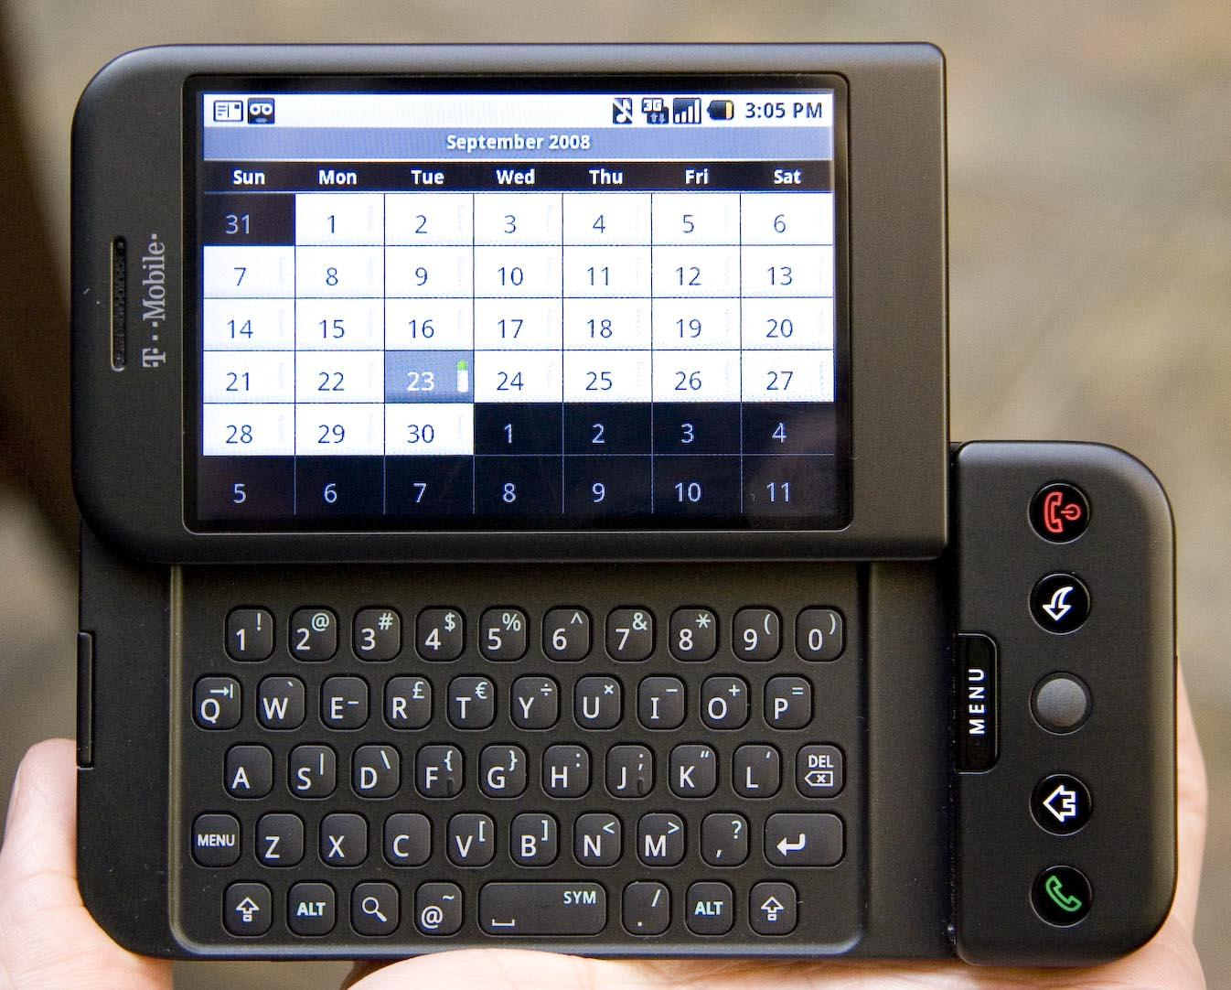
T-Mobile G1 / HTC Dream - 2008

Slide 6
What is Android ?
Android is an open-source software stack for mobile devices, and a corresponding open-source project led by Google.
http://source.android.com
you can get the code
you can modify if you want
you can build and deploy to your device

Slide 7
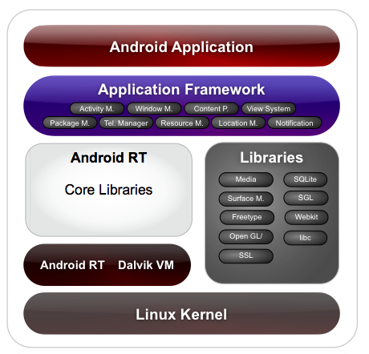
Android Software Stack
Java
Dalvik VM
Develop
using SDK
C/C++
Native
Develop
using NDK
Kernel
Root Level

Slide 8
Android Architecture
A multi user Linux system. Each application is a different user : Kernel level Application Sandbox
Every app run in its own Linux process, each process has its own VM
Permissions set at the install time
Complete isolation
For more on Security,
http://source.android.com/tech/security/index.html

Slide 9
What is Dalvik Virtual Machine (VM) ?
Software that runs the anroid apps
java > class > dex
javac dx
More suitable in terms of memory and processor speed
class is run by Java Virtual Machine
dex is run by Dalvik Virtual Machine
For more on DVM, http://davidehringer.com/software/android/The_Dalvik_Virtual_Machine.pdf

Slide 10
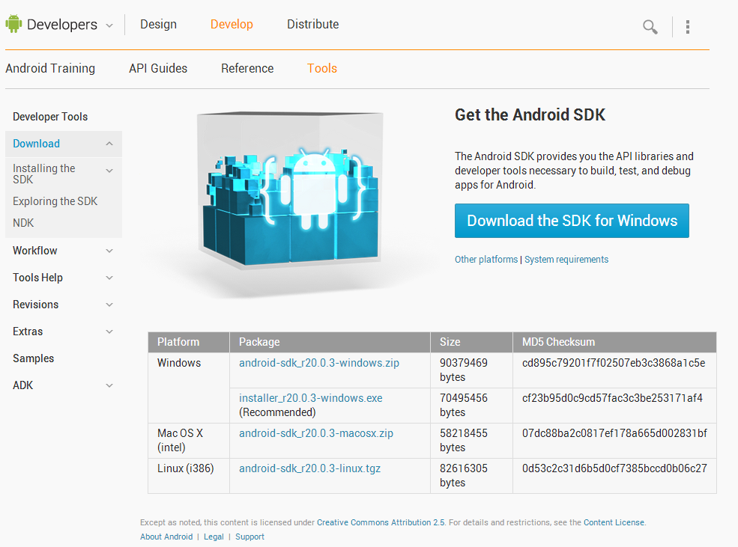
http://developer.android.com/sdk
SDK is for Java targeting Dalvik VM.
NDK is for C/C++ targeting native environment.You will probably need only SDK.

Slide 11
Android Developer Documentation
Extensive documentation at
http://developer.android.com
Check also Google IO Conference
https://developers.google.com/events/io/

Slide 12
API Levels
Android versions are mapped to API Levels. e.g. Android 4.1 is API Level 16
API features are available or not for a specific API Level. Some features are back-ported with Android Support Library.
4.0+ (API Level 14+) is 22% 2.3.3 - 2.3.7 (API Level 10) is 57%

Slide 13
API Levels
Cupcake (1.5 - API Level 3)
Donut
Eclair
Froyo
Gingerbread
Honeycomb (3.0 - API Level 11)
ICS (4.0 - API Level 14)
JellyBean (4.1 - API Level 16)
Key Lime Pie ???

Slide 14
Android Development Workflow
Setup development environment (SDK)
Build / Debug / Test (in your favorite IDE)
Virtual Device Setup / Physical Device
DDMS (Dalvik Debug Monitor Server)
LogCat
Lint
Publish (to Google Play)

Slide 15
First Android Project
Folders
Layouts and Views
R class
Android Manifest
Activity
Intent

Slide 16
Application Fundamentals
Activities
Intents and Intent Filters
Services
Content Providers
Broadcast Receivers
Fragments
Android Manifest - Permissions

Slide 17
Activity
* Typically correspond to one screen in a UI
* But, they can:
- be faceless
- return a value
* An application with User Interface, consist of one or more Activities
* Managed as an activity stack (LIFO)

Slide 18
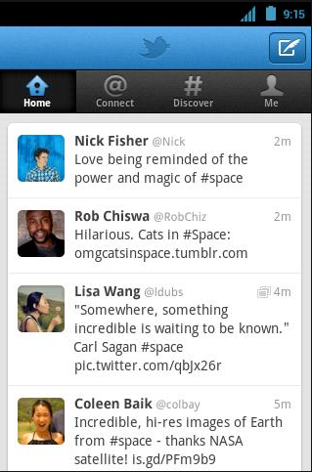
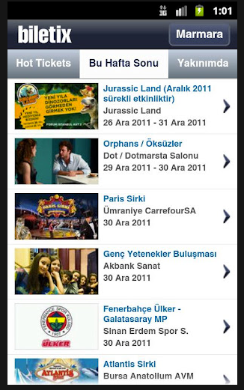
Activity

Slide 19
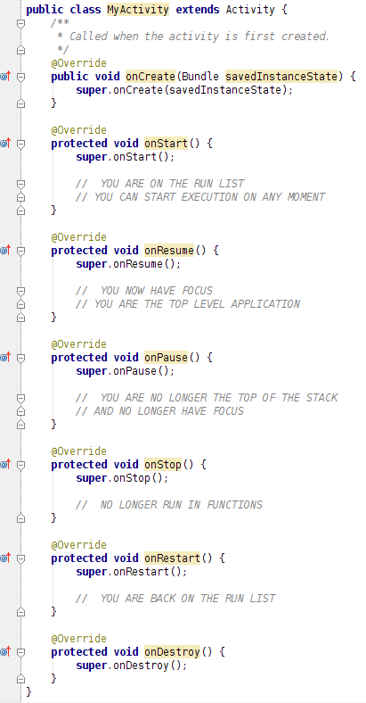
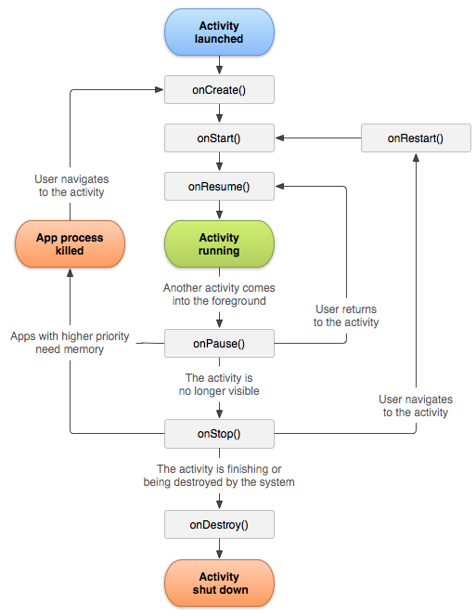

Slide 20
Activity
Activity States managed by the Android system
Declaration in the android manifest file
"Main Activity" must be set
http://developer.android.com/guide/components/activities.html

Slide 21
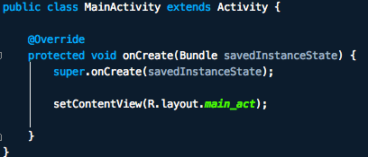
Activity
Activity with UI content

Slide 22
Intent
Intention
Passive data structure holding an abstract description of an operation to be performed
A message to the OS that you want to do something

Slide 23
Intent
Primary Attributes :
action : General action to be performed (ACTION_VIEW, ACTION_MAIN etc..)
data : Data to operate on, expressed as a URI
Depending on how Intent is constructed, Android system determines what to do e.g finds the appropriate activity, service, or set of broadcast receivers

Slide 24
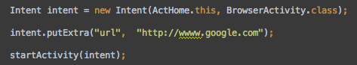
Intent - Explicit
Used to navigate from one Activity to another in app
Daha transfer between Activities

Slide 25
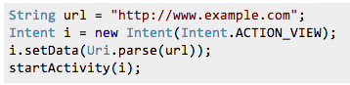
Intent - Implicit
Used to open other applications
Ex : Open a specific URL in a user's preferred browser

Slide 26
Intent
IPC mechanism
Depending on how Intent is constructed, Android system finds the appropriate activity, service, or set of broadcast receivers to respond the intent

Slide 27
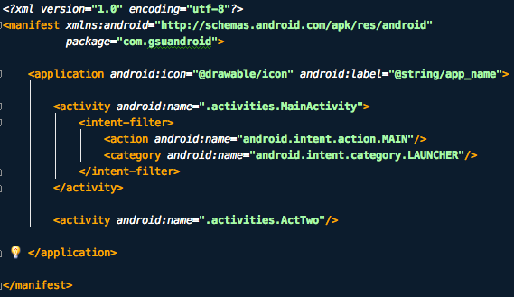
Intent Filter
Description of what intent an activity is capable of handling
"Main" Activity :

Slide 28
Intent Filter
Depending on how Intent is constructed, Android system finds the appropriate activity, service, or set of broadcast receivers to respond the intent

Slide 29
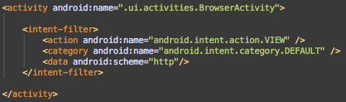
Intent Filter - Crappy Browser
Register for intent

Slide 30
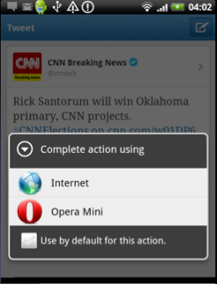
Intent Filter
Receive Intent

Slide 31
Broadcast Receiver
Component which allows to register for system or application events
You cannot trigger system Broadcasts, Android will prevent it; you can define your own actions
System Broadcasts:
Intent.ACTION_BOOT_COMPLETED
Intent.ACTION_BATTERY_LOW
Intent.ACTION_POWER_DISCONNECTED
etc..

Slide 32
Services
Faceless
Runs in the background
Pre-defined Services :
Context.LAYOUT_INFLATOR_SERVICE
Context.LOCATION_SERVICE
Might run on its own thread or in activity

Slide 33
Content Provider
Access to a central repository of data
Intended to be used by other applications
IPC
Contacts, Calendar, your own custom provider etc.

Slide 34
User Interface @ Android

Slide 35
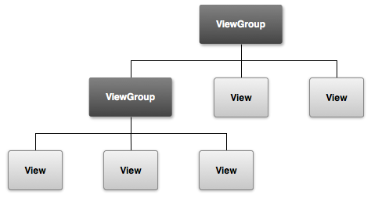
Overview
* UI is defined by hierarchy of View's and ViewGroup's.
* Views are highly customizable. You can even create your own custom views.
* Layouts can be created from code programmatically or can be defined in XML files.
* Both methods have advantages

Slide 36
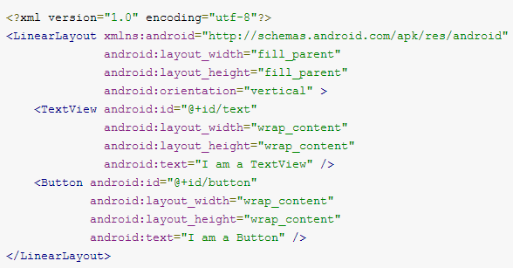
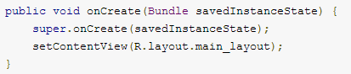
Overview
* View's created in XML files can be referenced from code via ID's.
* We should set content view if layout is defined in XML file:

Slide 37
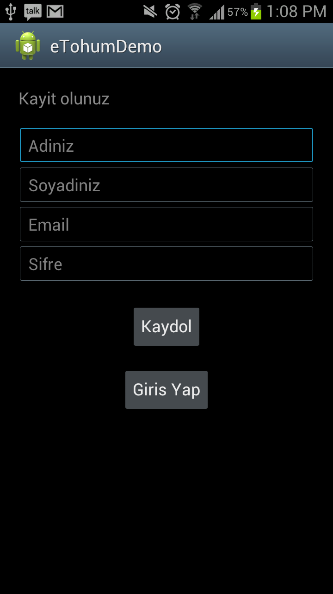
User Interface
Demo

Slide 38
UI - Dialogs
* Small windows used for notifying user or perform small actions(confirmation, login etc)
new AlertDialog.Builder(this) .setTitle("uyari") .setMessage("doldurulmamis alanlar var. yine de kayit yapilsin mi") .setCancelable(false) .setPositiveButton("evet", new DialogInterface.OnClickListener() { public void onClick(DialogInterface dialog, int id) { register(); } }) .setNegativeButton("hayir", null).show();

Slide 39
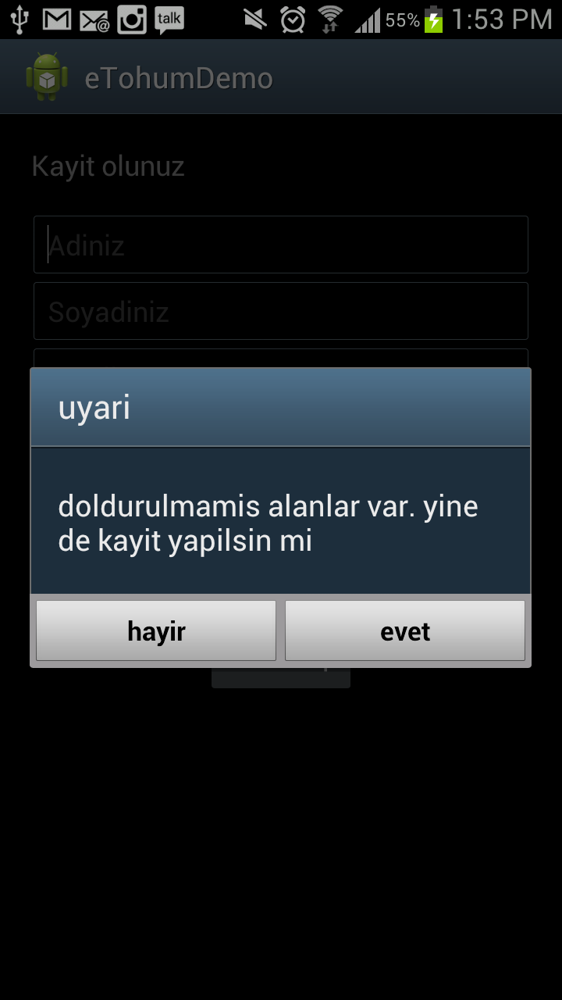
Dialogs Demo

Slide 40
UI - ActionBar
* Introduced in Honeycomb (API 11)
* Powerful widget used for navigation and perform user actions
* Backward compatible via SherlockActionBar: 3rd party library developed by Jake Wharton
http://actionbarsherlock.com/
* Enables standardization between applications.

Slide 41
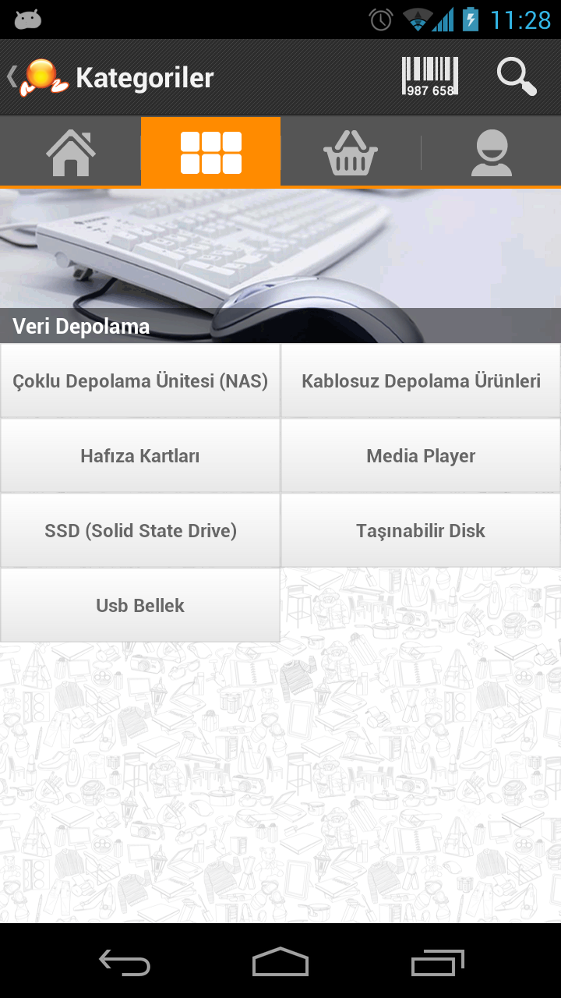
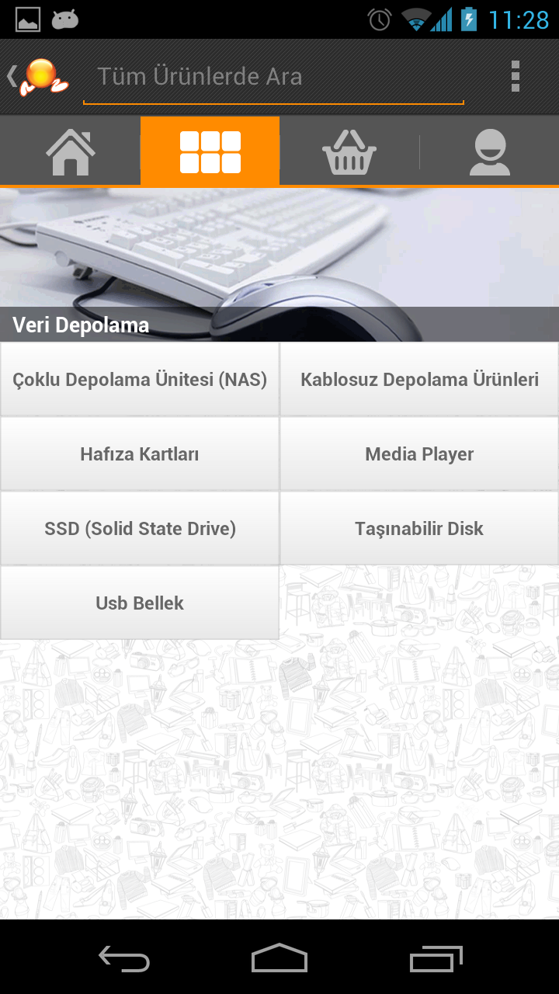
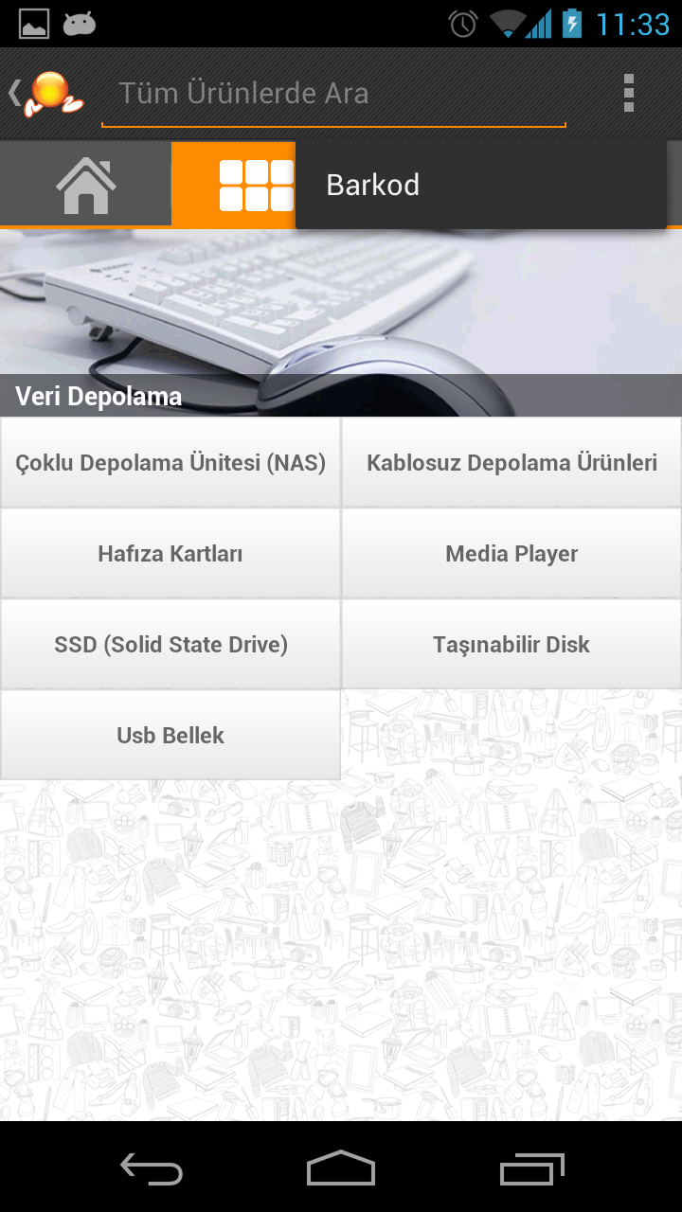
UI - ActionBar

Slide 42
Notifications @ Android

Slide 43
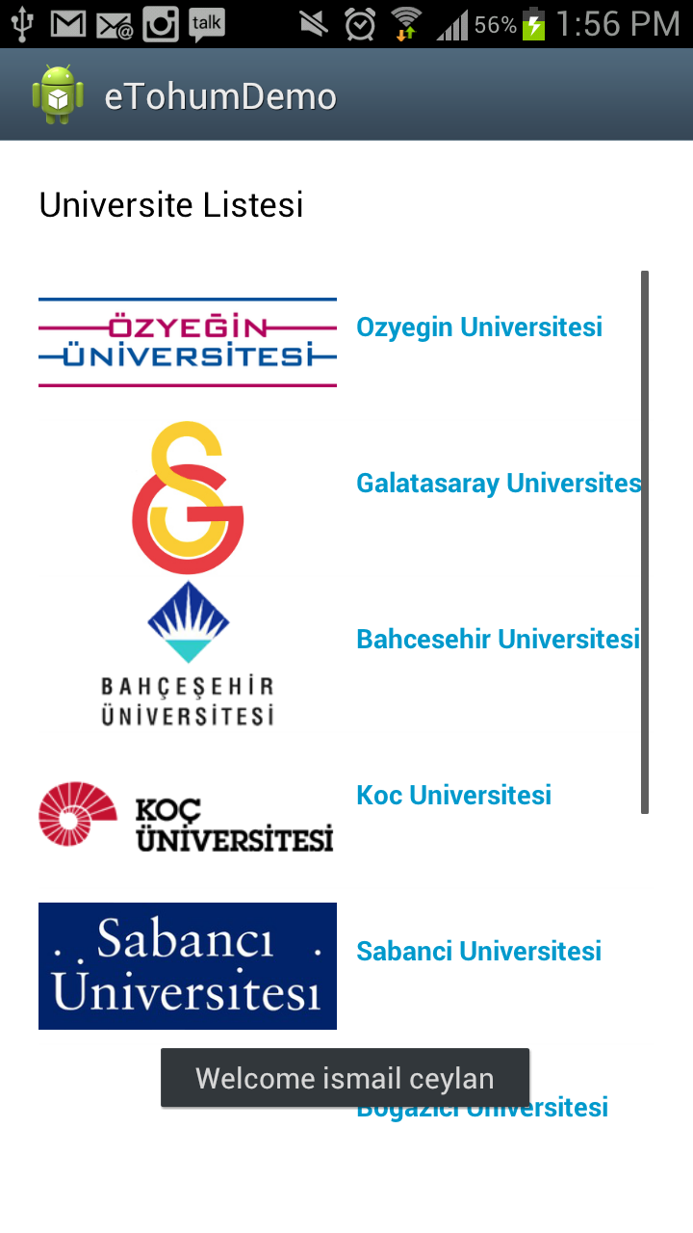
Toast Notification
Simple non-persistent popup text notifications to inform user and doesn't require user response.
Toast.makeText(context, context.getString(R.string.welcome) + " " + name, Toast.LENGTH_LONG).show();

Slide 44
Status Notification
Adds an icon and ticker message to the status bar.
Shows a message in the notification window
Can send intent to application, if user clicks.
Can perform actions without opening application.

Slide 45
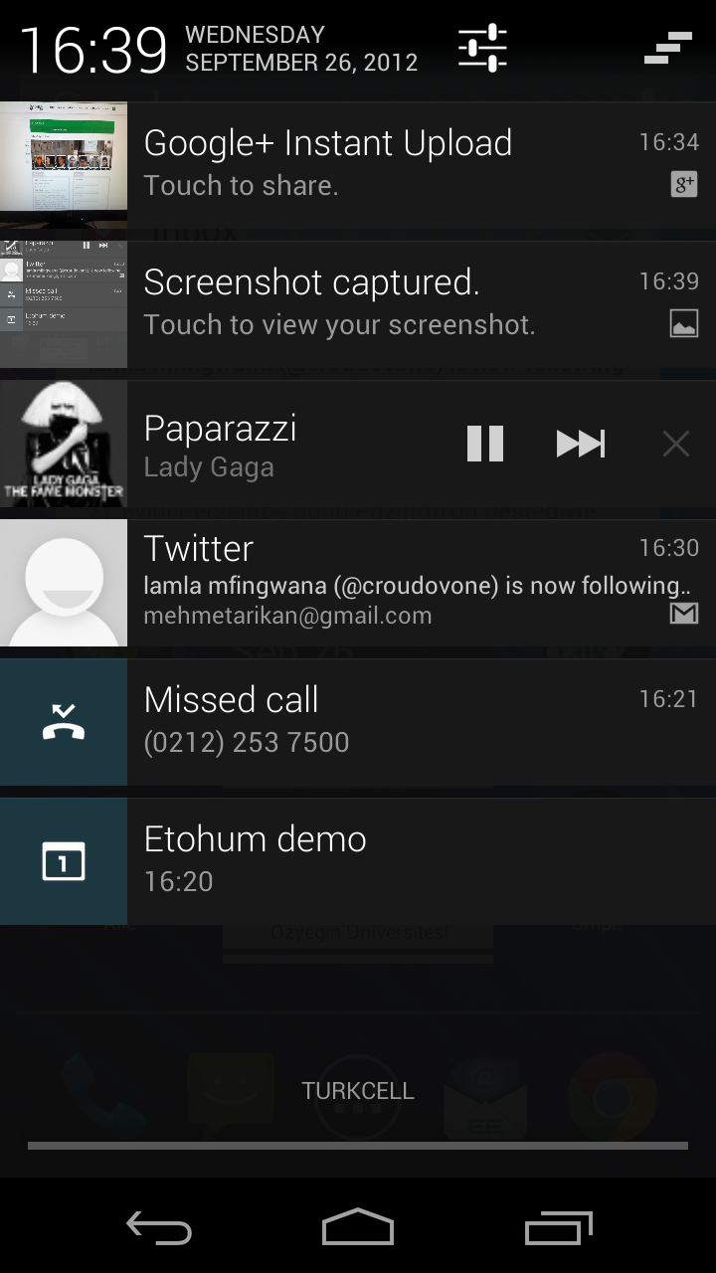
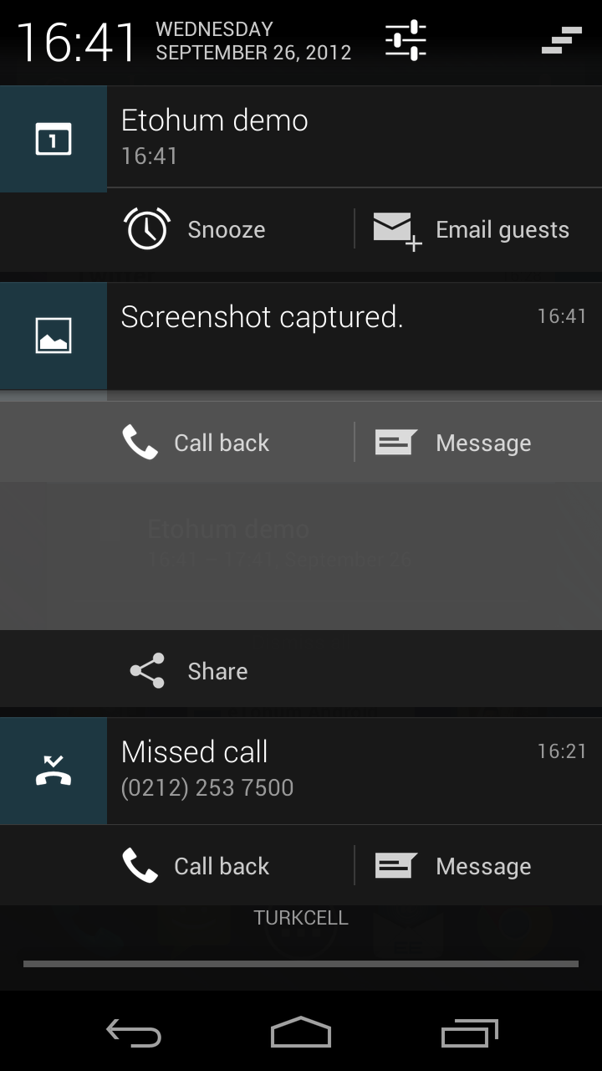
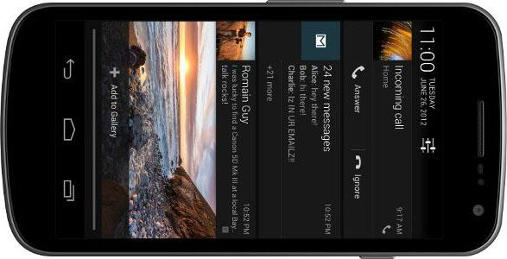
Status Notification

Slide 46
Toast Notification
Demo

Slide 47
Supporting Different Devices @ Android
Language
Android Versions
Screens (density, resolution, size)

Slide 48
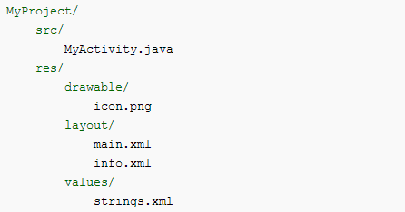
Resources - Overview
Externalization of resources (strings, images, animations) from source code.
Improves maintainability of project.
Allows easily support different device types

Slide 49
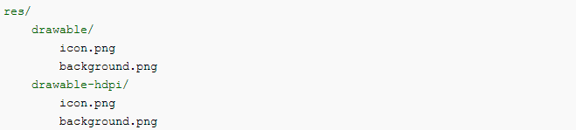
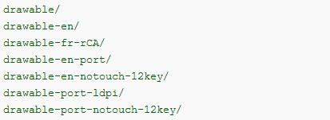
Resources
We can provide alternative resources for different devices.
Possible configurations: screen width, screen height, screen density, screen size, screen orientation, API level, language and region etc...

Slide 50
Accessing Resources
On compile time a R class containing id's for resources is generated.
Can be referenced from both xml and code.
<string name="hello">Hello!</string>
In code : R.string.hello
IN XML : @string/hello
EditText editText= (ImageView) findViewById(R.id.editText); editText.setText(R.string.hello);
or
editText.setText(context.getResources.getString(R.string.hello));
<EditText xmlns:android="http://schemas.android.com/apk/res/android" android:id="@+id/editText" android:layout_width="fill_parent" android:layout_height="fill_parent" android:textColor="@android:color/secondary_text_dark" android:text="@string/hello" />

Slide 51
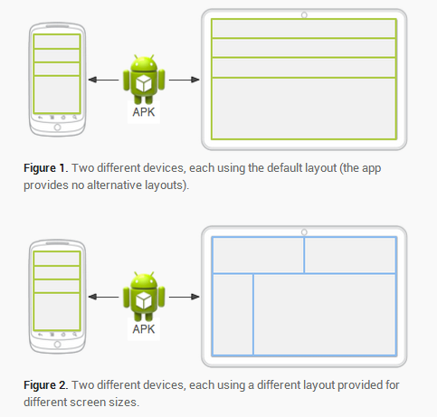
Supporting Different Devices

Slide 52
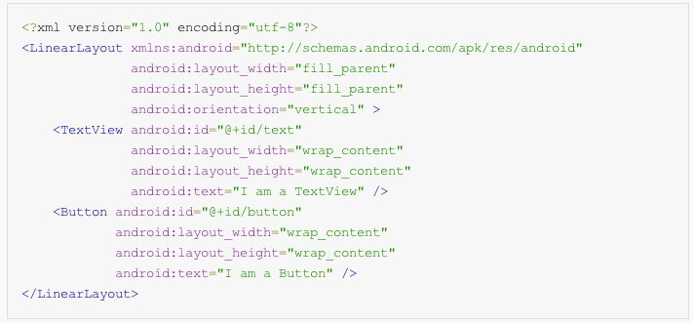
Views - XML

Slide 53
Views
Common Layouts:
Linear Layout
Relative Layout
List View
Grid View

Slide 54
Fragments
Reusable UI modules
Avoid switching between activities; use Fragments instead
Introduced with Honeycomb
Dynamic and Flexible UI
Backward Compatible via Support Library

Slide 55
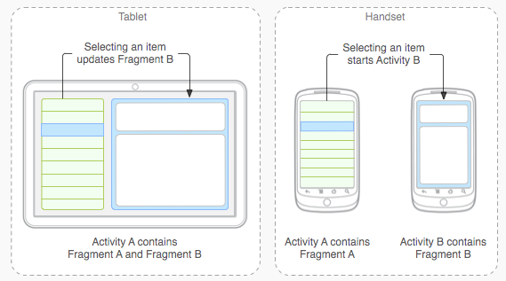
Fragments

Slide 56
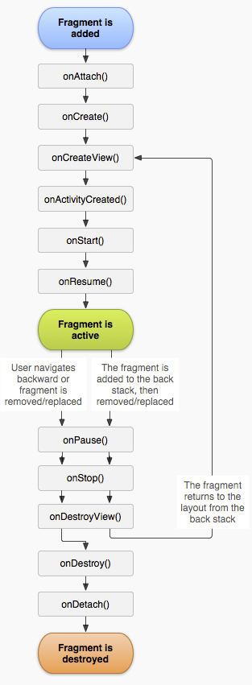
Fragments
Has its own lifecycle, consumes input events
Embedded in activities and lifecycle directly affected by the host activity's lifecycle
Back stack managed by the activity

Slide 57
Android Manifest
* Presents essential information about the application to the Android system
- Names the Java package
- Describes the components:
* activities, services, content providers
- Declares which permission the application must have, the minimum level of the Android API, libraries etc...
- Declares hardware and software features used

Slide 58
Application Fundamentals
Demo

Slide 59
Localization
Provide resources for each language you want to support. Make sure there is default resources as well.
res/ values/ strings.xml
<string name="hello">Merhaba!</string>
<string name="goodbye">Güle güle!</string>
arrays.xml
values-en/ strings.xml
<string name="hello">Hello!</string>
<string name="welcome">Welcome!</string>

Slide 60
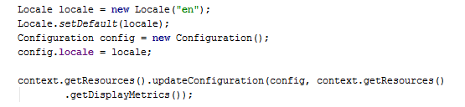
Localization
Uses device's region.
For custom language :

Slide 61
UI - Styling and Theming
* Style: collection of properties specify the look and format of a View.
* Styles are defined in a separate file from layouts.
* Can be reused for different views.
* Can be inherited from other styles
* Reduces code duplication.
Theme: A Style applied to entire application or activity.

Slide 62
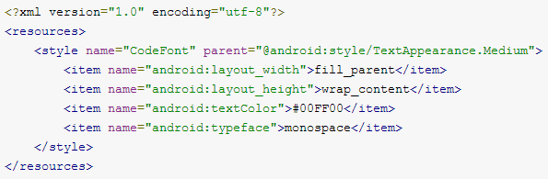
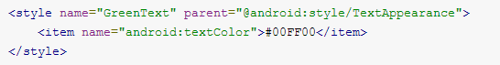
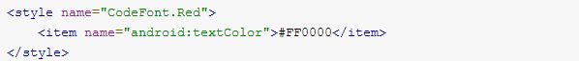
UI - Styles
* Create an XML file under /res/values directory.
* Each style should be defined via <style> tag.

Slide 63
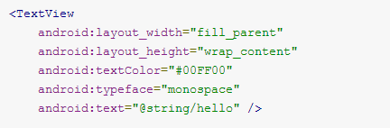
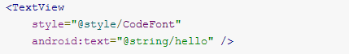
UI - Styles
* Now we can use our styles.
is reduced to
and can be applied to other TextView's.

Slide 64
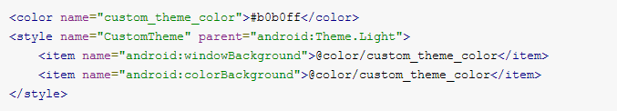
UI - Theme
* Similar to styles
but should be applied to application or activity in manifest file
or

Slide 65
Threads @ Android

Slide 66
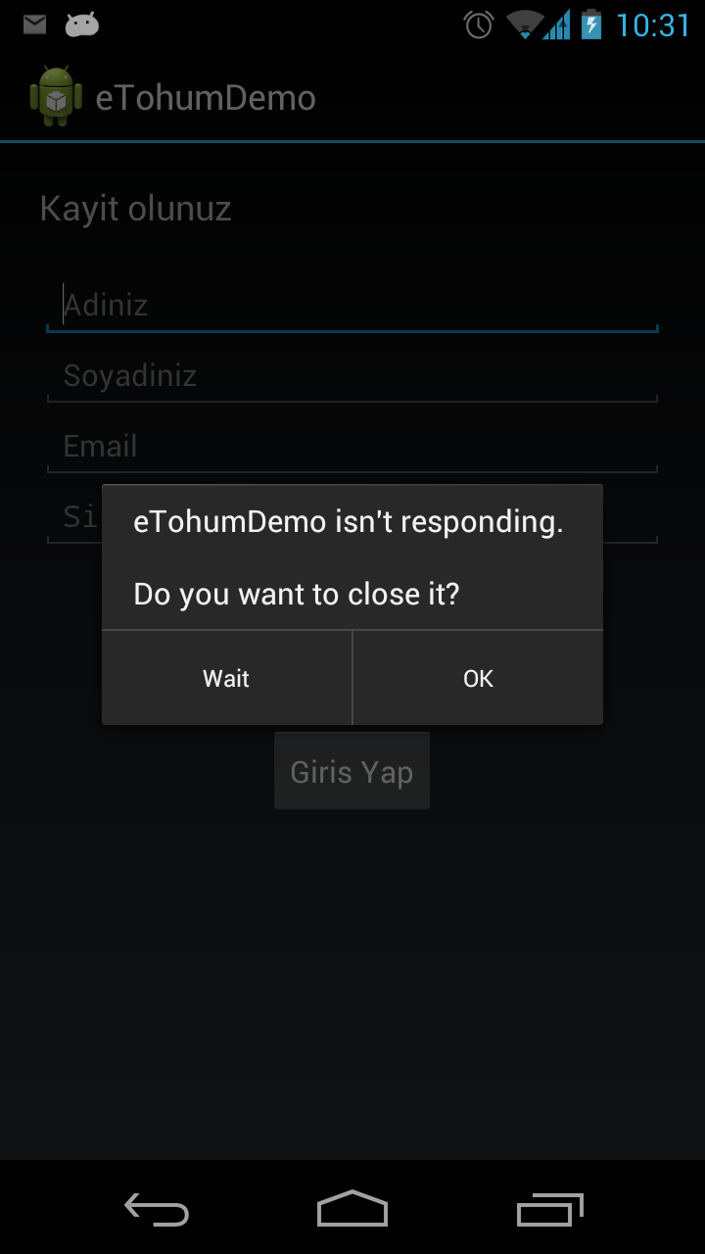
Asynchronous Tasks
Do NOT block UI (main) thread
* ANR(Application not responding) :
- No response to user input within 5 seconds
- A BroadcastReciever hasn't finished executing in 10 seconds
* Conventional Solution: Threads
* Android approach: AsyncTasks
* Runs on background and notifies you when you need to update the UI.

Slide 67
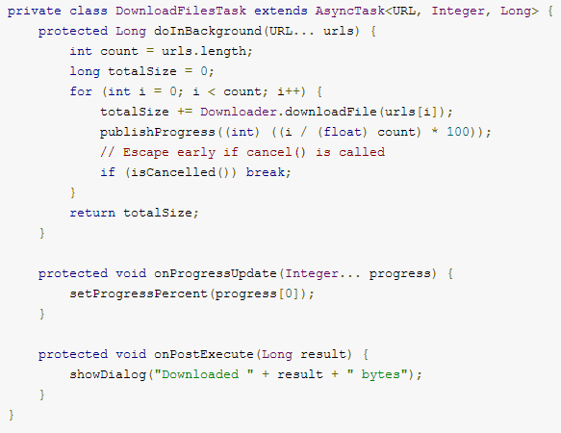
Asynchronous Tasks

Slide 68
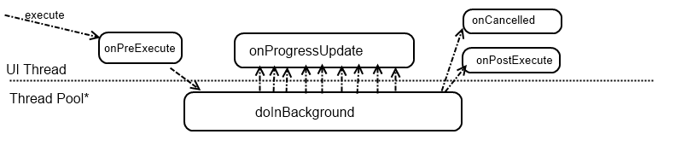
Asynchronous Tasks
- Workflow of AsyncTask :
* When first introduced, AsyncTasks were executed serially on a single background thread. Starting with DONUT, this was changed to a pool of threads allowing multiple tasks to operate in parallel. Starting with HONEYCOMB, tasks are executed on a single thread to avoid common application errors caused by parallel execution.
* For parallel execution executeOnExecutor(java.util.concurrent.Executor, Object[]) with THREAD_POOL_EXECUTOR.

Slide 69
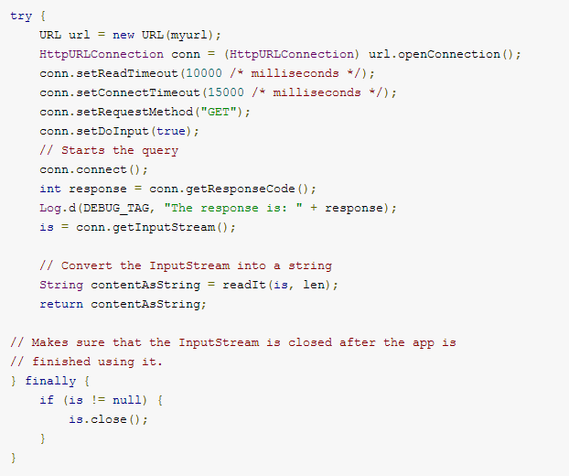
Network Connection

Slide 70
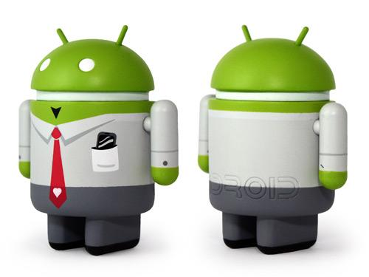
Lists and Adapters
ListView
Adapters

Slide 71
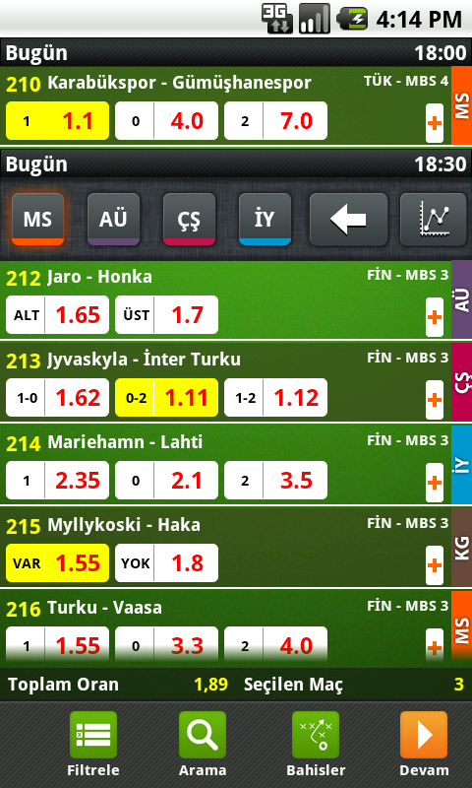
ListView
* View group to display a list of scrollable items
* Large data set - performance
* Handling data changes
* ¿ Smooth scrolling
* ¿ Fetching data efficiently

Slide 72
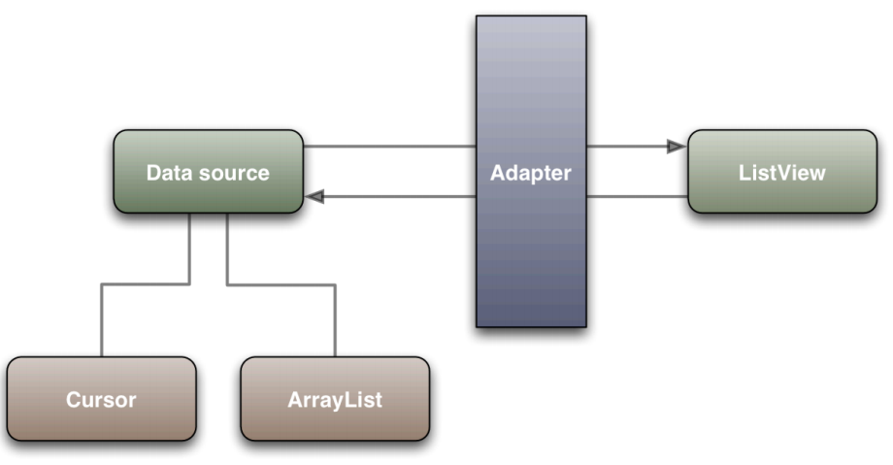
Adapters - man in the middle

Slide 73
Adapters
* Terminology
- index: Child views
- position: Data in Adapter
- id: Unique identifier for data
- Local view cache
- Accessing views from the adapter
- Change convertView’s structure
- Assumptions about getView calls

Slide 74
Adapters
getView(int position, View convertView, ViewGroup parent)
– Full data presentation control
– Optimization
* ListView is smart
* convertView
- Supplied by ListView
- Matches item types
- Reuse it

Slide 75
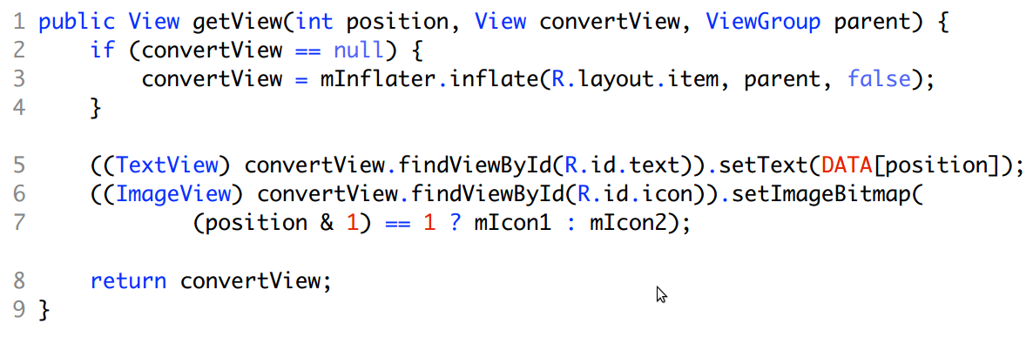
Adapters - DON'T

Slide 76
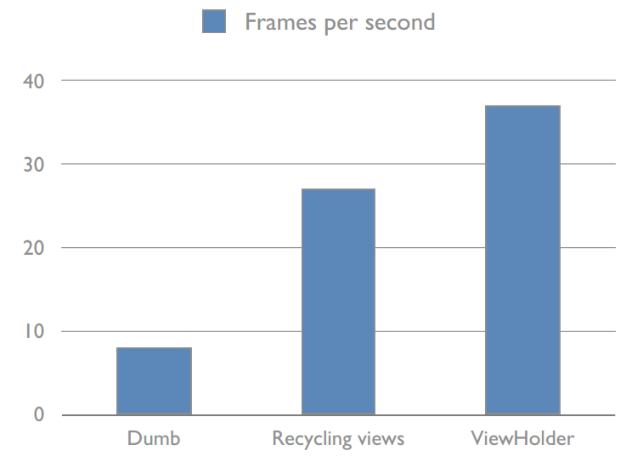
Performance

Slide 77
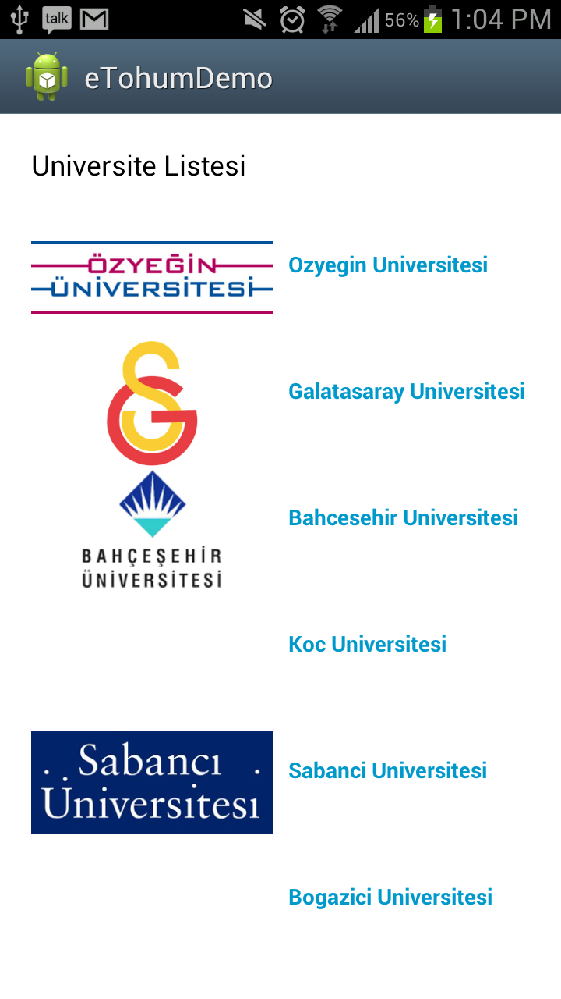
ListView Demo

Slide 78
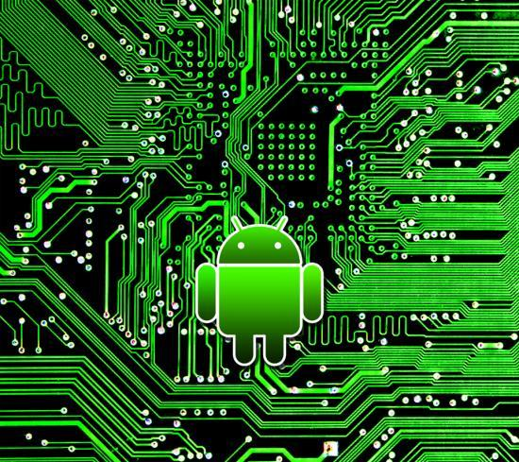
Location @ Android

Slide 79
Location Strategies
* GPS
- pros: most accurate
- cons: only works outdoors, consumes battery, and slow
* Android Network Location Provider
- pros: fast, less battery consumption
- cons: uses cell towers and Wi-Fi signals

Slide 80

¡ Challenges !
* Multitude of location sources
- trade-offs (gps, cell-id, Wi-Fi)
* User movement
- people walks, drives....
* Varying accuracy

Slide 81


Requesting Location Updates
lastKnownLocation:

Slide 82
Data Storage @ Android

Slide 83
Data Storage
Shared Preferences
Store private primitive key-value pairs
Internal/External Storage
Store private data in internal storage
Public data in external storage
SQLite
Private database
SQLite 3
Data Backup
Backup data to cloud and restore when application is reinstalled

Slide 84


Publishing the Application

Slide 85
Publishing the Application
All applications must be signed
Special debug key created by SDK
Self signed certificates; no certificate authority needed

Slide 86
We are hiring !
ik@pozitron.com
Android / Java
iOS / Objective-C Windows Phone / C#
Backend / Java, Scala, Python
Web Frontend / HTML5, JavaScript

Slide 87
You can download slides and demos @
https://github.com/cnlms/SabanciWorkshop

Slide 88
Rotten Android Project
Movie stuff (reviews, cast info, ratings, critics etc.)
Accessible over a public API
http://developer.rottentomatoes.com/docs

